Slide 1

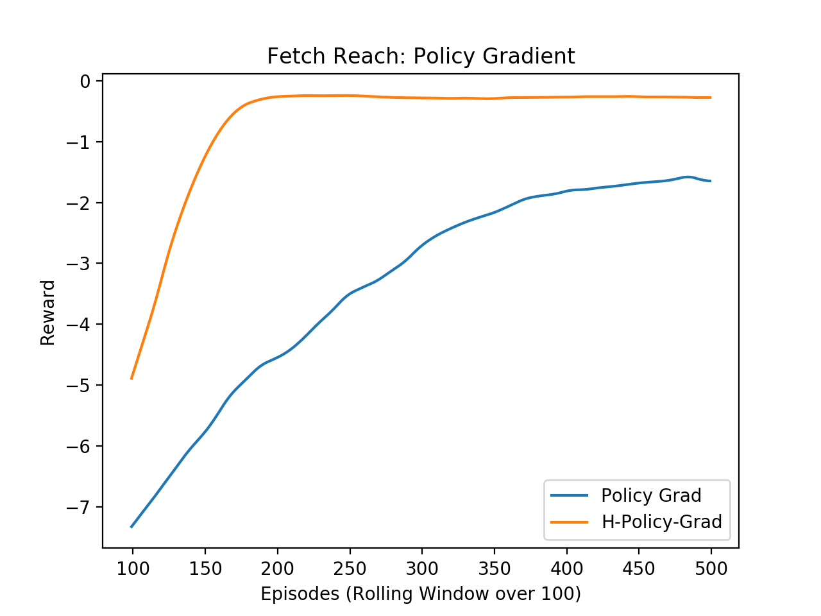
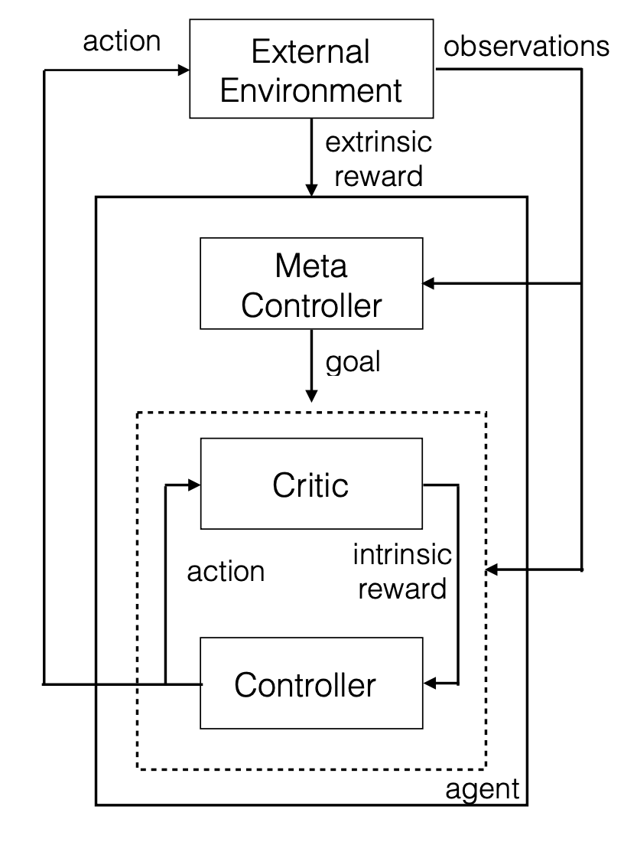
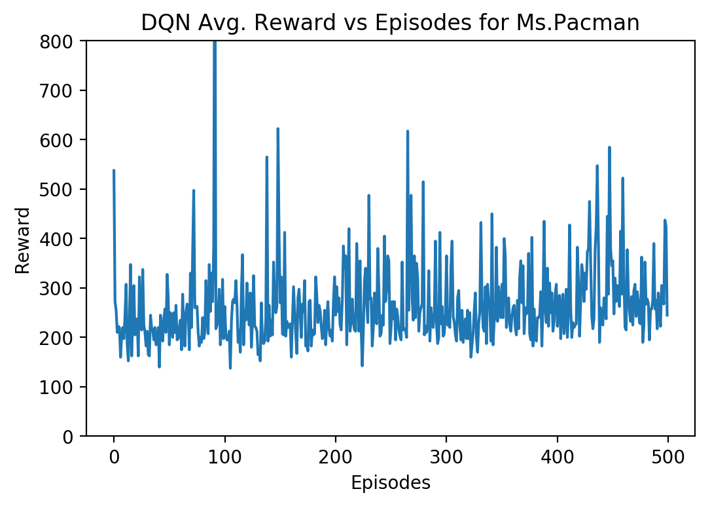

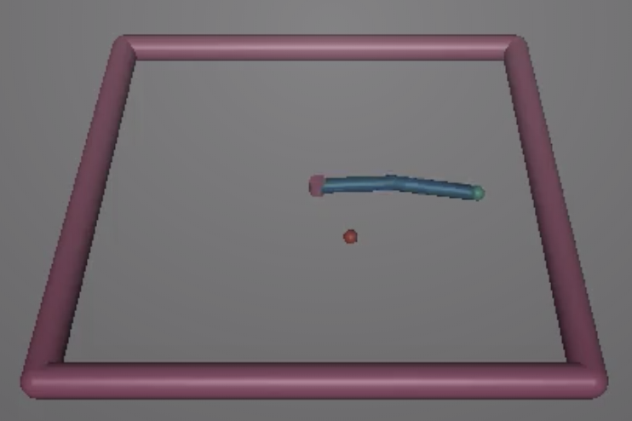
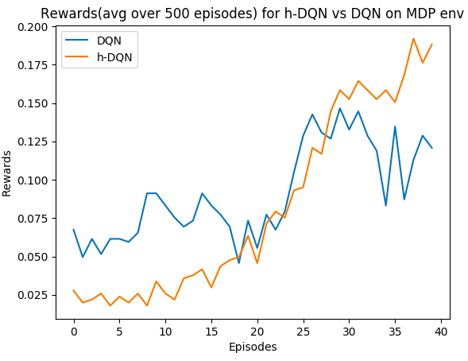
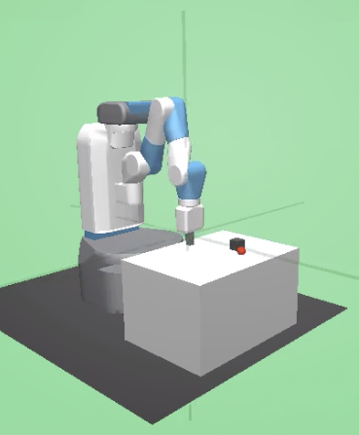
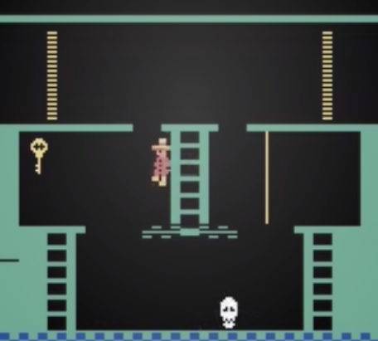
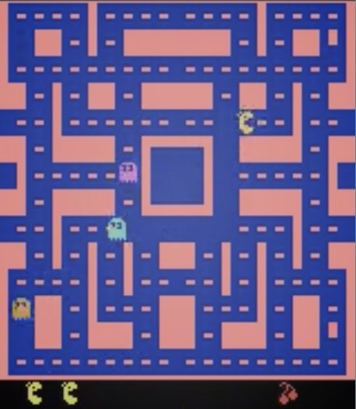
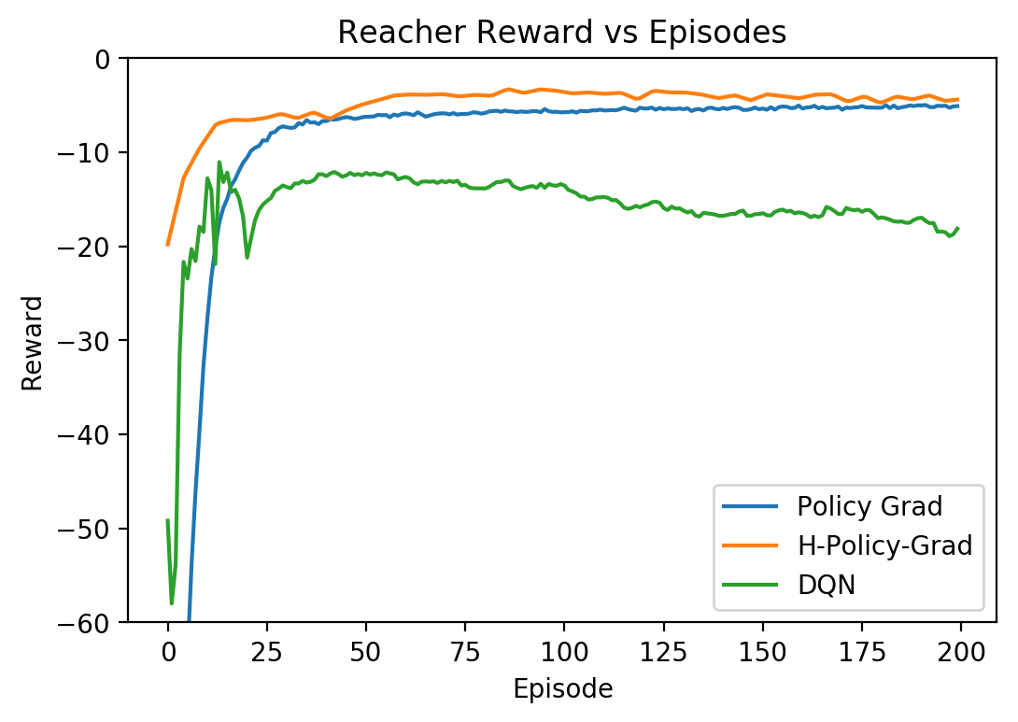
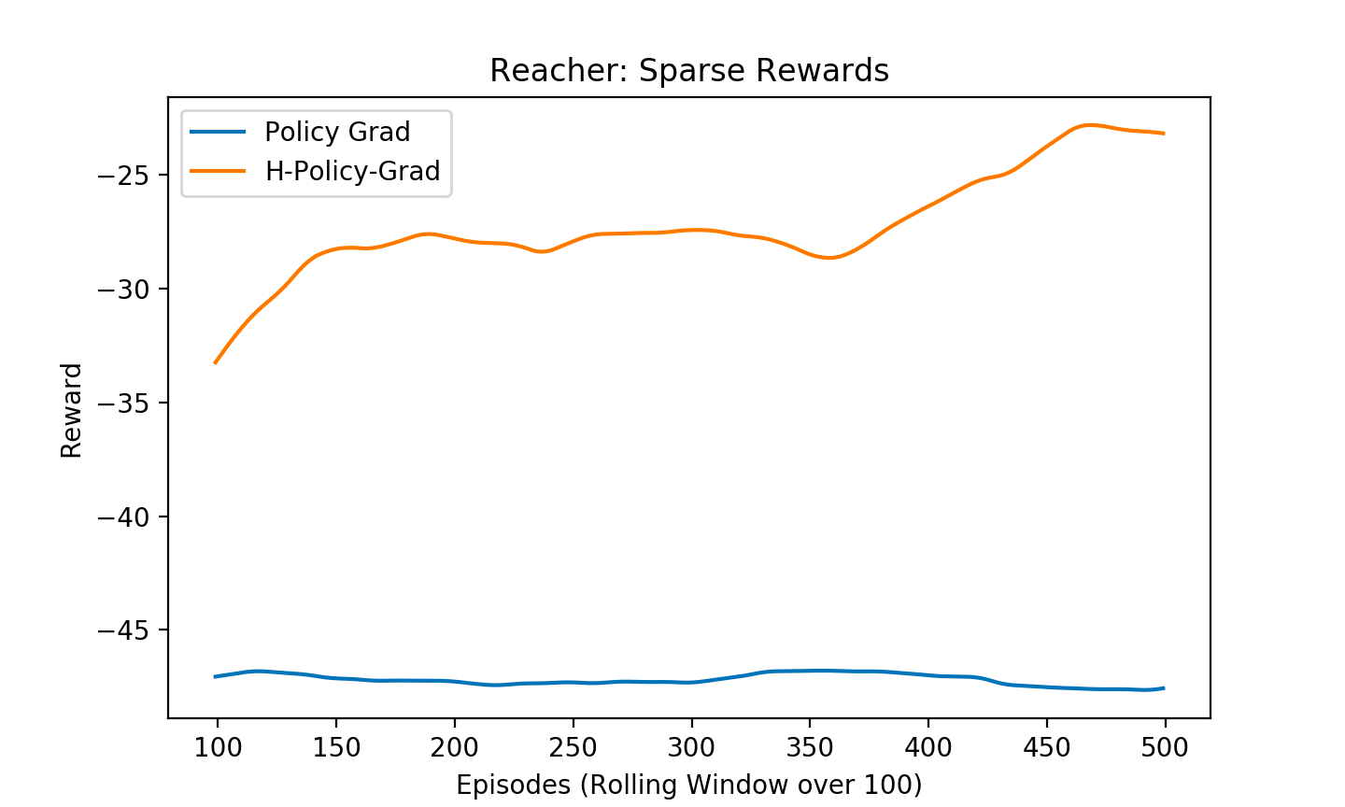
Analysis of Subgoal Generation for Hierarchical RL
Raunaq Bhirangi (rbhirang), Nishant Gurunath (ngurunat),
Aniruddh Shetty (anirudds), Scott Sun (scottsun) (Group #2)
Motivation
Methods
Fetch Robot:
Complex behaviors are comprised of multiple levels of decision making; replicating these behaviors requires an agent capture this ability
Flat policy learners are difficult to train for tasks with sparse rewards
Hierarchical RL operates at multiple temporal scales to supplement an overall goal with several subgoals
Manually constructing subgoals for each environment is difficult
Learning subgoals would improve scalability (if it works)
General Hierarchical Framework
Agent produces actions and receives sensory observations
Meta-controller produces policy over goals based on states
Internal critic checks if subgoal is reached and provides appropriate intrinsic reward to the controller
Controller produces a policy over actions based on the intrinsic reward from the internal critic
Proposed models
Hierarchical DQNs and Policy Gradient Methods
User-defined space of subgoals
Meta-controller trained to select from user-defined subgoal space
Controller trained until convergence on subgoal space
Fully-learned space of subgoals (Feudal Network)
Meta-controller trained to select from arbitrary subgoal space
Controller trained simultaneously to respond to each subgoal
Subgoal space: Six directions for the arm to move in 3D space
Intrinsic reward: Distance from the subgoal target
Larger state space than 2-D Reacher
Ms. Pacman
Subgoal space: Locations of power pellets
Intrinsic reward: Distance from the subgoal target
Environments
Stochastic MDP
Toy environment to verify performance of hierarchical networks
Starting in state s₂, get r=1 if we reach s_{last} before s₁, otherwise r=0.01
OpenAI MuJoCo Reacher
Simple environment for 2-segment arm to reach a point
Good comparison between DQN and policy gradient methods
Continuous actions and states
OpenAI MuJoCo Fetch Robot
Control multi-joint Fetch robot to reach a target
Continuous actions and states
OpenAI ATARI
(Montezuma’s Revenge and Ms. Pacman)
Process video or RAM from ATARI games
Discrete actions, continuous states
Observations
Results
Hierarchical models are more performant than flat models; they learn better for complicated tasks
Training to convergence is more difficult than with conventional deep RL methods
While HRL is marginally better than conventional deep RL methods in dense reward environments, it is much more sample efficient with sparse rewards
Stochastic MDP:
Subgoal space: All states in the MDP
Intrinsic reward: Same as the maximum extrinsic reward
References
Reacher:
Al-Shedivat, M., Lee, L., Salakhutdinov, R., and Xing, E. On the Complexity of Exploration in Goal-Driven Navigation.
D. Kulkarni, T., Rajagopal Narasimhan, K., Saeedi, A., and B. Tenenbaum, J. Hierarchical deep reinforcement learning: Integrating temporal abstraction and intrinsic motivation.
Vezhnevets, A. S., Osindero, S., Schaul, T., Heess, N.,Jaderberg, M., Silver, D., and Kavukcuoglu, K. Feudal networks for hierarchical reinforcement learning.
Mohammed Ghavamzadeh, Sridhar Mahadevan, Hierarchical policy gradient algorithms
Subgoal space: Four directions for the arm to move in
Intrinsic reward: Distance from the subgoal target.
Baseline Models
Tabular Q Learning
Deep Q Network (DQN)
Deep network trained to approximate the Q function, off-policy
Policy Gradient
Deep network trained to output prob over action space, on-policy
Works better than DQN for continuous action spaces

